Slide 1
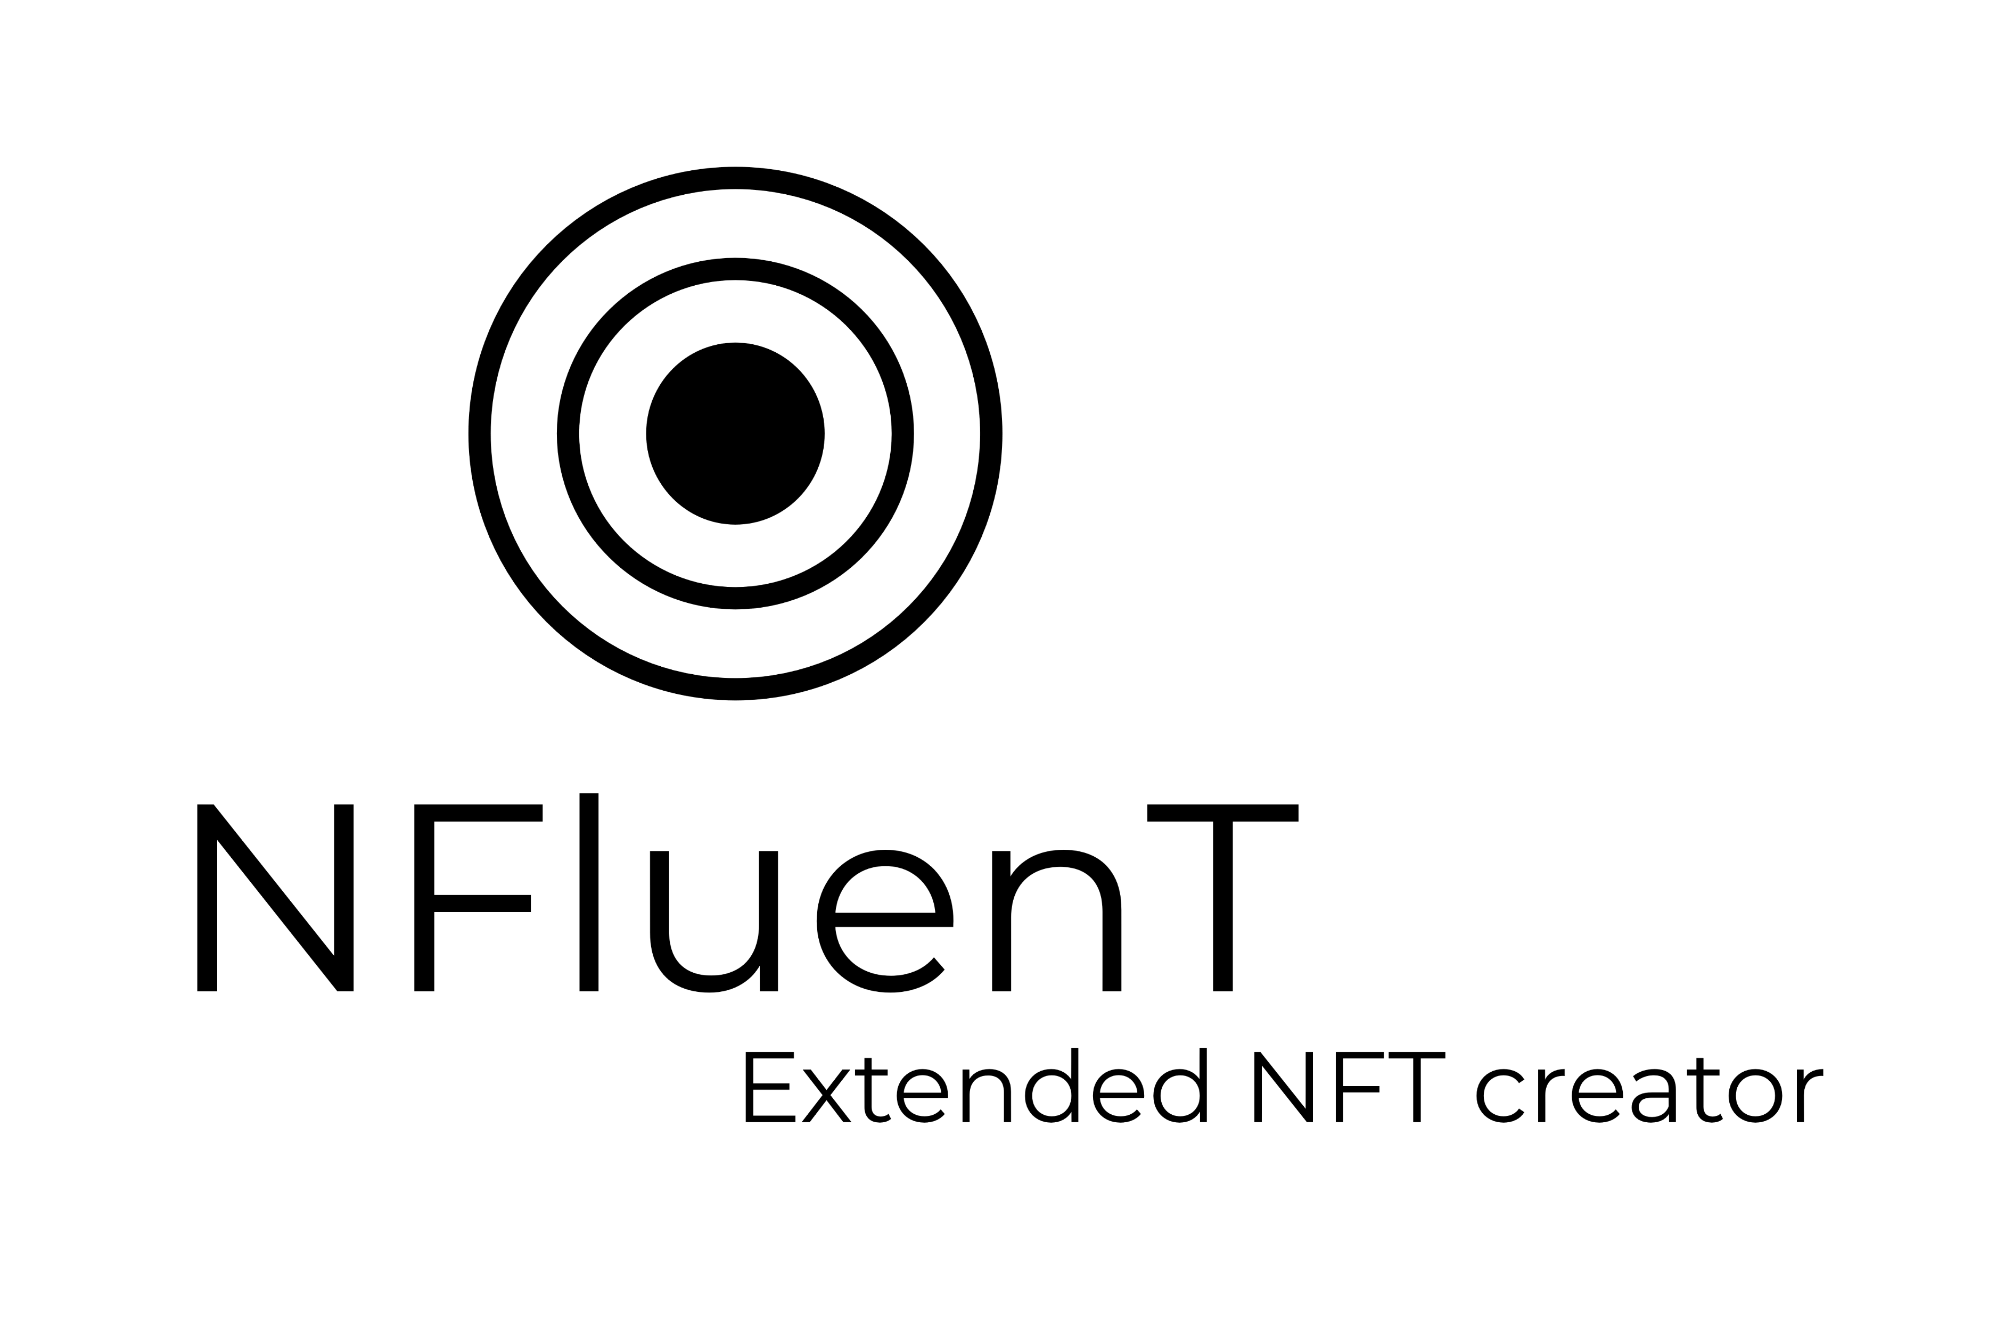
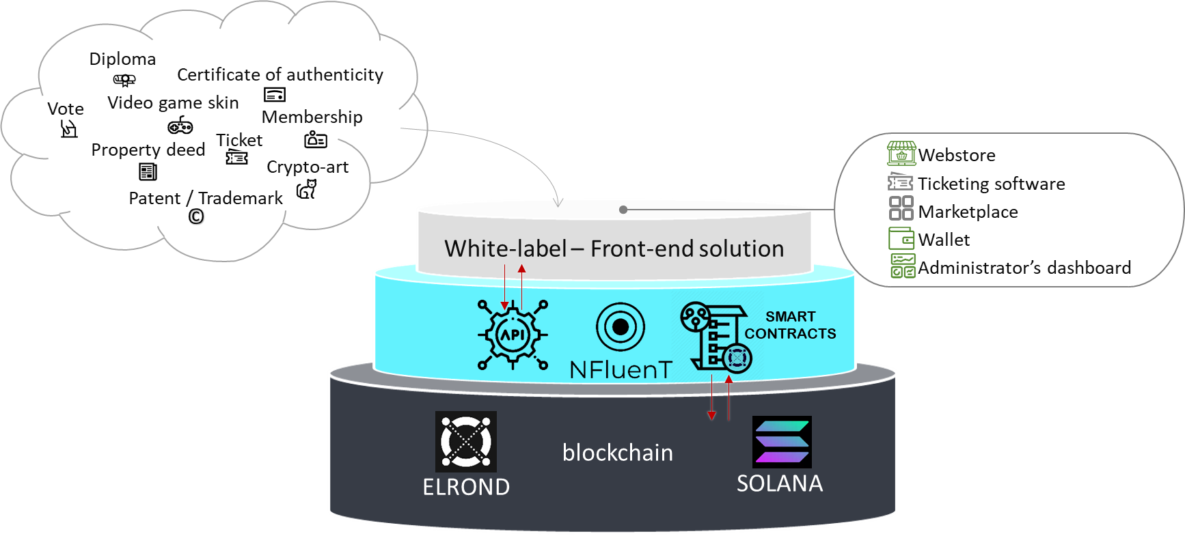
Project
Vision
Services
Team
Contact
What can you do with NFluenT?
How it works ?
Our vision
The extended NFT
XNFTs usefulness positioning
WHAT IS NFluenT ?
NFluenT is an NFT agency dedicated to the management of Non-Fungible Tokens.
From the strategy definition to implementation,
we bring your NFT projects to life.
We create, sell, distribute, store, manage, secure and track your digital assets.

Slide 2






Diapositive 10
WHAT CAN YOU DO WITH NFluenT?
innovate
create NFTs
sell NFTs
use NFT technology to
offfer new services,
generate new revenues
mint NFTs
containing any digital asset
on your store/marketplace,
thanks to a distributror
regulate NFTs
track NFTs
promote NFTs
secure/control transactions,
grant revenues/benefits
blockchain explorers,
analytics web tools
use resellers’ marketplace,
awareness on social channels
IG, Twttr, Discord
2

Slide 3

Diapositive 10
HOW IT WORKS ?
Step 1: Preliminary study
Requirements.
Strategy.
Technical specifications.
Step 2: Build
Front NFT store/marketplace.
API connection.
Smart contract setup.
Step 3: Sell NFTs
Core attributes.
Mint & sale.
Resale.
Payment.
Auction.
Price control.
Governance.
Royalties.
Benefits.
Certificates.
Step 4: Promote your NFTs
Raise awareness on social channels IG, Twttr, Discord, NFTLaunches.
SEO management.
- Use resellers’ marketplace to promote the NFT.
3

Slide 4
Diapositive 5
Our vision
We at NFLUENT have convictions about NFTs.
We believe that NFTs can serve the user.
We believe in NFTs that make sense, that add value.
We believe in NFTs that bring innovation to real life.
We believe in augmented NFTs.
We deliver X-NFTs.
4

Slide 5










Diapositive 5
THE EXTENDED NFT
AUCTION
NFluenT is implementing innovative customized functionalities on basic NFTs to create X-NFTs.
CORE ATTRIBUTES
BENEFITS
RESALE
Name and visuals
Scarcity, price
Characteristics of the asset
Floor price
Time limited auction
Resellers authorized/blocked
Second market control
Uninhibiting first-time buyer
Discount on NFTs purchasing
IRL benefits (printout, VIP access …)
Access to virtual events
PRICE CONTROL
GOVERNANCE
Initial price setup
Resell markup
ROYALTIES
DAO (Decentralized Autonomous Organization)
Vote
Participative decision
CERTIFICATES
Revenue granted to Creator
Revenue granted to Producer
Donation to nonprofits
Digital art property
Authenticity certificate
Property deed (patent, trademark, phycical asset)
5

Slide 6







Diapositive 5
XNFTs USEFULNESS POSITIONING
in real life
ROYALTIES
AUCTION
BENEFITS
GOVERNANCE
existing
CORE ATTRIBUTES
innovative
RESALE
CERTIFICATES
PRICE CONTROL
digitalized
6

Slide 7
Diapositive 10
WHAT ARE THE SERVICES OFFRERED BY NFluenT ?
CONSULTING SERVICES
SMART CONTRACT SETUP
NFluenT helps you to :
- collecte the business requirements,
- define the strategy,
- write the technical specifications,
for your NFT project.
billing
NFluenT adapts the Smart contract to your use case.
billing
man-day
man-day
API CONNECTION
IGNITION & MONITORING
NFluenT connects your front-end application to the blockchain.
Promotion of your NFTs.
billing
NFluenT brings your NFTs to life and monitors the transactions.
billing
man-day
fixed minting cost
+
trading fees
7

Slide 8


Diapositive 5
THE TEAM
Thomas
LAFFOURCADE
Hervé
HOAREAU
20 years of experience in project management and finance
La Villette
La Tour Eiffel
Bateaux Parisiens
Compagnie des Alpes
Auditoire
FullSIX
Bouygues Bâtiment
Education
Master finance d’entreprise – ASSAS
Languages
English, German
Business areas
Tourism
Communication
Construction
Health
20 years of experience in project management and IT
Groupe SFR
Capgemini
Education
Diplôme Universitaire Paris Descartes – Analyste Big Data
Ecole Supérieure d’Informatique Electronique et Automatique (E.S.I.E.A) – Ingénieur Informatique
Languages
Anglais
Business areas
Web
Télécoms
Industrie automobile
8

Slide 9
Diapositive 10
CONTACT

